Slide 1
The Impossible Made Possible
Text: Mark 9:23
Evangelist James R. Reynolds, Sr.
Preached August 14, 2009 in the Gospel Tent

Slide 2
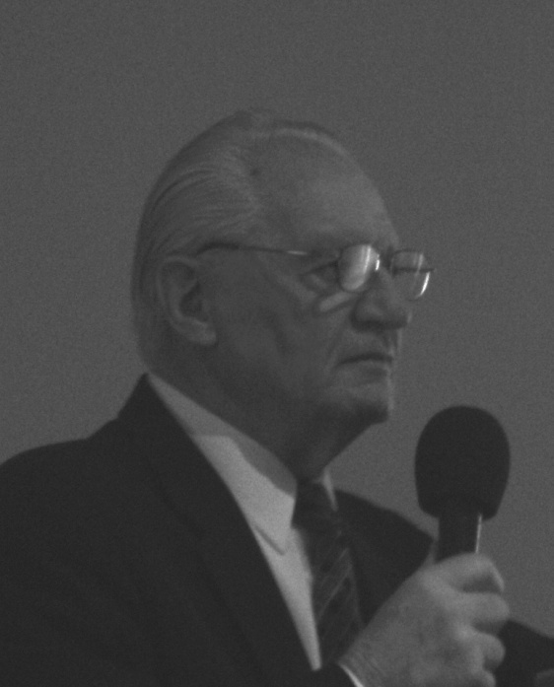
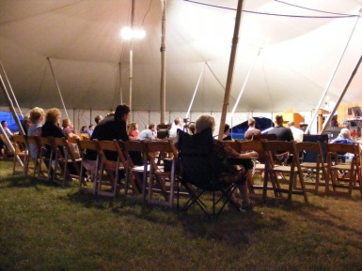
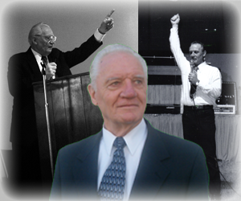


The Impossible Made Possible
Evangelist:
Rev. James R. Reynolds, Sr.
Text:
Mark 9:23
Preached:
August 14, 2009
Under the Gospel Tent
www.deliverance.me
Contact: sgrjr@deliverance.me

Slide 3
The Impossible Made Possible
Mark 9:23
Jesus said unto him, If thou canst believe, all things are possible to him that believeth.

